Slide 1
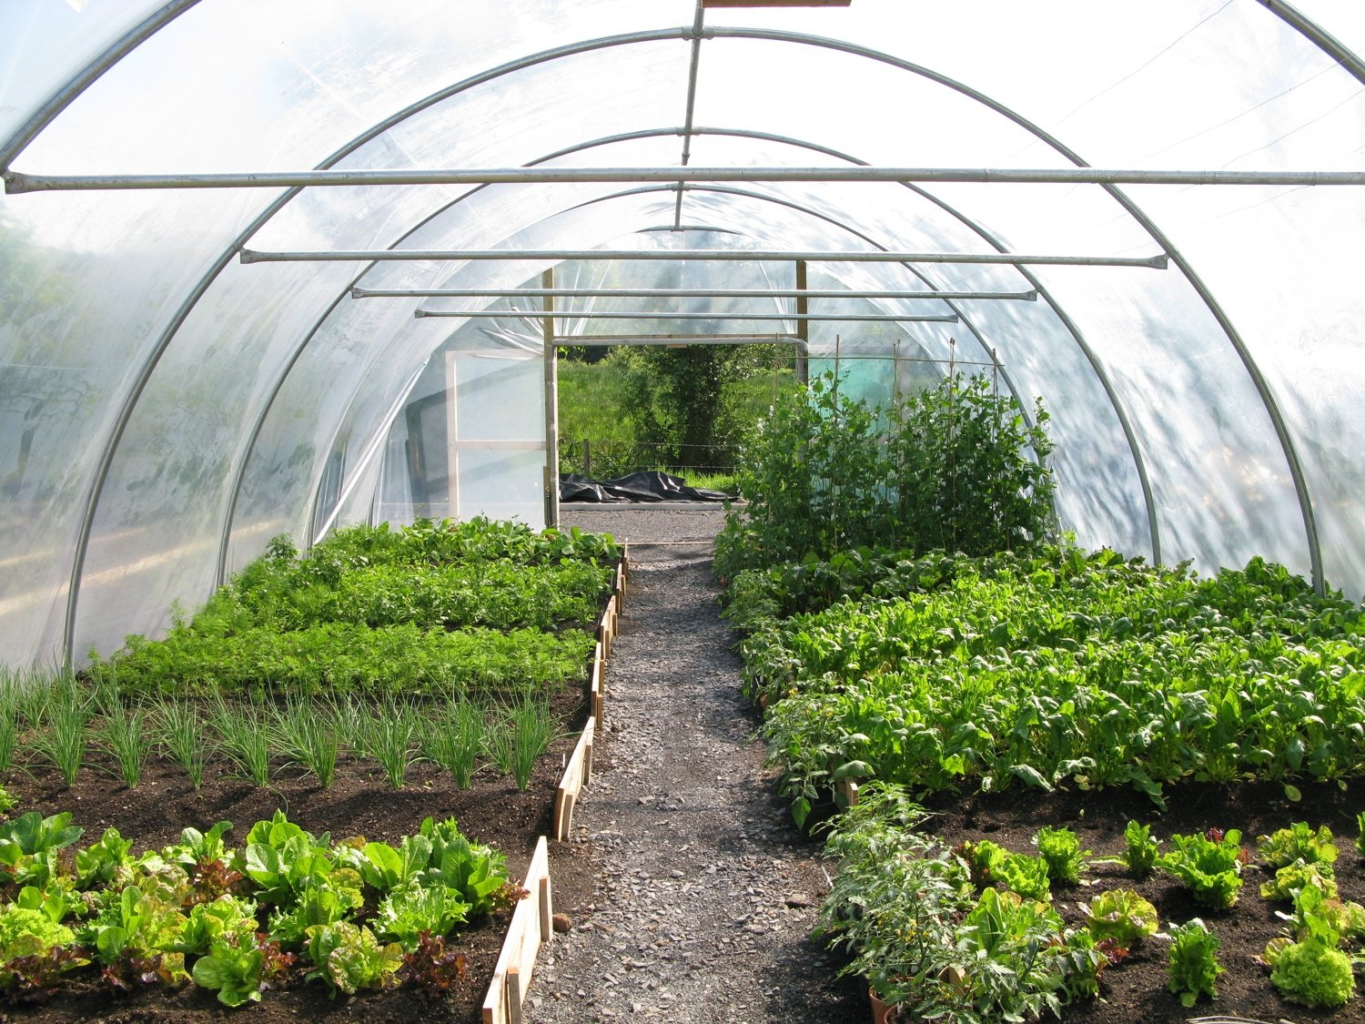
https://www.perplexity.ai/search/poly-tunnel-EEDwXOUpSriFTQzKSp9_2w

Slide 2
Polytunnels, also known as grow tunnels, are structures designed to create a controlled environment for growing plants, extending the growing season and protecting crops from adverse weather conditions. They are particularly popular among both commercial growers and home gardeners due to their versatility and cost-effectiveness.
Advantages of Polytunnels
Extended Growing Season: Polytunnels allow for earlier planting in spring and later harvesting in autumn, making them ideal for a variety of crops that might otherwise struggle in the UK’s variable climate
Protection from Elements: They shield plants from harsh weather, pests, and animals, which can lead to more successful growth and higher yields
Cost-Effective: Compared to traditional greenhouses, polytunnels are generally less expensive to purchase and maintain. For instance, a basic polytunnel can cost significantly less than a comparable greenhouse

Slide 3
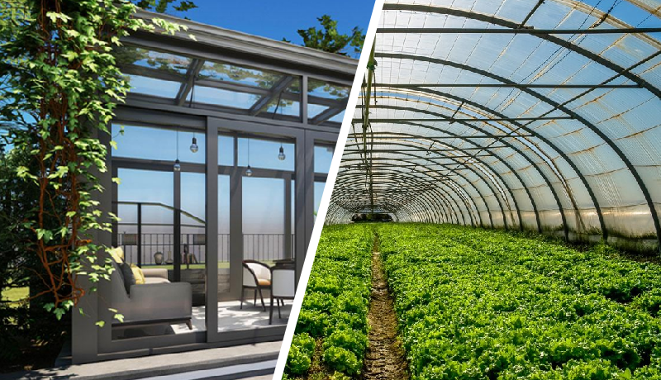
Glass House vs Green House

Slide 4
Feature | Greenhouse | Glasshouse
Material | Can be made of glass or plastic film | Strictly made of glass
Light Transmission | Varies based on material; generally good | Excellent light diffusion (95%+)
Cost | Generally more affordable to construct | Higher initial investment
Durability | Less durable, may require material replacement | Highly durable, long-lasting
Maintenance | Requires periodic maintenance | Minimal maintenance needed
Insulation | Can vary; typically lower than glass | Superior insulation properties
Flexibility | More flexible design options | Fixed structure with less customization
Environmental Impact | Plastic can contribute to waste | Glass is recyclable and more sustainable

Slide 5
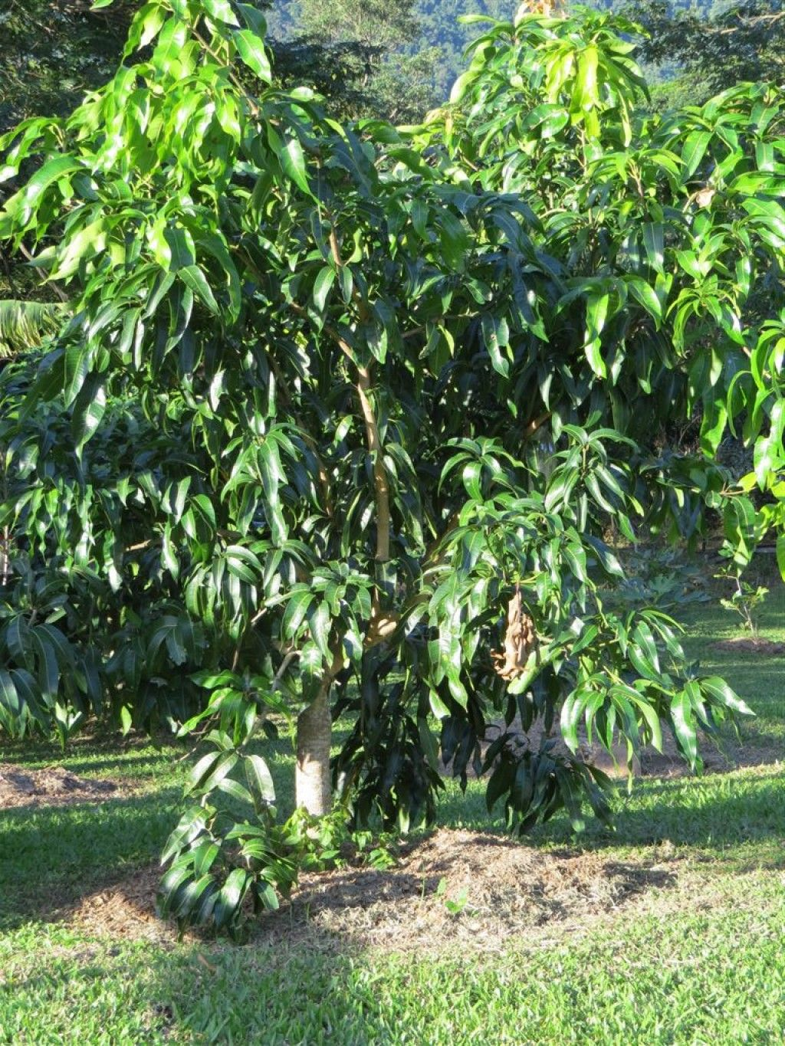
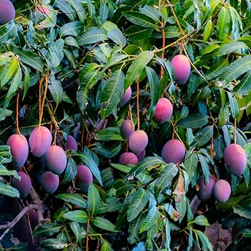
Propagation from seeds is a fundamental method of plant reproduction that involves growing new plants from seeds. Seed is mature ovule , ovary is fruit

Slide 6
Advantages of Seed-Based Propagation
Genetic Diversity: Seeds promote genetic variation, which can lead to stronger and more resilient plant varieties. This diversity is beneficial for adapting to changing environmental conditions and resisting diseases1
Long-Term Storage: Seeds can be stored for extended periods without losing viability, allowing for future planting opportunities and preserving plant species
Wide Distribution: Seeds can be naturally dispersed by wind, water, or animals, facilitating the colonization of new areas and contributing to ecosystem diversity
Cost-Effectiveness: Seedlings are generally cheaper to produce compared to plants propagated through other methods like grafting or cuttings, making them accessible for both commercial growers and hobbyists
Hybrid Vigor: Seed propagation allows for the creation of hybrids with superior qualities, which can enhance growth rates, yield, and resilience compared to their parent plants
Disadvantages of Seed-Based Propagation
Time-Consuming: The process of germination and growth from seed to maturity takes considerable time, which may delay harvests compared to faster propagation methods
Uncertainty in Germination: Not all seeds will germinate, and the resulting plants may not exhibit the same desirable traits as the parent plant, leading to variability in quality
Difficult Retention of Traits: Due to genetic variation, it can be challenging to consistently retain superior qualities in offspring, especially in hybrid varieties
Environmental Sensitivity: Seed germination is highly dependent on specific environmental conditions (moisture, temperature), making it susceptible to failure if conditions are not optimal
Initial Care Requirements: Newly germinated seedlings require careful attention and maintenance (watering, fertilization), which can be labor-intensive and requires knowledge of proper care techniques

Slide 7
Seed Viability
Seed viability refers to the ability of a seed to germinate and develop into a healthy seedling under suitable conditions. Viability is influenced by several factors, including genetic makeup, environmental conditions during seed development, and storage practices.
Factors Affecting Viability
Genetic Factors: Different species exhibit varying levels of seed viability due to inherent genetic traits. For example, some species may have seeds that naturally have lower viability rates due to their physiological characteristics
Storage Conditions: Seeds stored in cool and dry environments tend to maintain higher viability compared to those stored in warm and humid conditions. High moisture content can accelerate deterioration, leading to loss of viability
Ageing: Over time, seeds lose viability as they age. This process is affected by environmental factors such as temperature and humidity during storage, which can lead to oxidative stress and other biochemical changes that impair germination

Slide 8
Seed germination, marking the transition from a dormant seed to an active growing seedling(emergence of radicle). This process can be categorized into various types based on different criteria. Here’s an overview of seed germination and its types.
Seed Germination Process
The germination of seeds involves several key stages:
Imbibition: The process begins with the absorption of water by the dry seed. This hydration activates enzymes and initiates metabolic processes within the seed, causing it to swell and soften the seed coat
Activation of Metabolic Processes: Once water is absorbed, hydrolytic enzymes break down stored food reserves (starch, proteins, and fats) into simpler compounds that the embryo can utilize for growth
Radicle Emergence: The first root, known as the radicle, emerges downward, anchoring the seedling and allowing it to absorb water and nutrients from the soil
Shoot Emergence: Following root development, the shoot (hypocotyl) grows upward, pushing through the soil surface. The cotyledons (seed leaves) unfold to begin photosynthesis
Establishment of Seedling: The seedling continues to grow, developing true leaves and further root systems to support its growth and nutrient uptake

Slide 9
Types of Germination
Seed germination can be classified into several types based on different criteria:1.
1. Epigeal (Epi=above, geal=soil)-Germination
Description: In epigeal germination, the cotyledons (seed leaves) emerge above the soil surface during germination.
Examples: Common in many dicotyledonous plants such as beans and sunflowers.
2. Hypogeal Germination
Description: In hypogeal germination, the cotyledons remain below the soil surface while the shoot grows upward.
Examples: Typical in monocotyledonous plants like peas and maize.
3. Viviparous Germination
Description: This type occurs when seeds germinate while still attached to the parent plant, leading to seedlings that develop before detaching.
Examples: Common in mangroves and some tropical plant such mango.

Slide 10
Feature | Epigeal Germination | Hypogeal Germination
Cotyledon Position | Cotyledons emerge above the soil surface. | Cotyledons remain below the soil surface.
Hypocotyl Growth | Hypocotyl elongates significantly to lift cotyledons above ground. | Hypocotyl does not elongate much; epicotyl grows upward.
Plumule Protection | Plumule is protected by cotyledons until it emerges. | Plumule is protected by the curved epicotyl during growth.
Photosynthesis Role | Cotyledons become green and function as the first leaves. | Cotyledons do not participate in photosynthesis.
Examples | Common in plants like castor and sunflowers. | Common in plants like peas and maize.

Slide 11
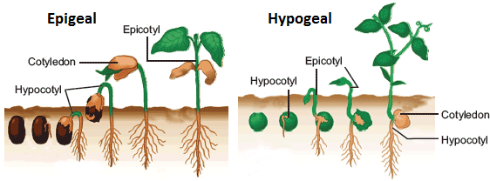

Slide 12
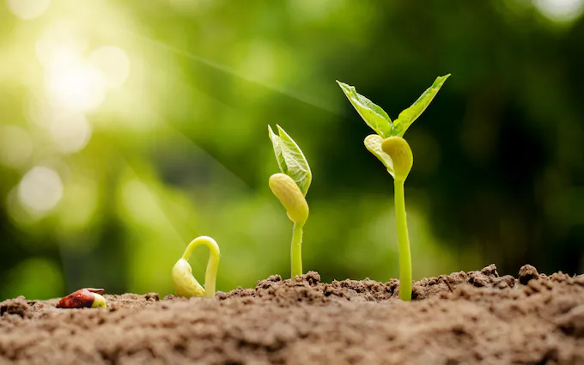
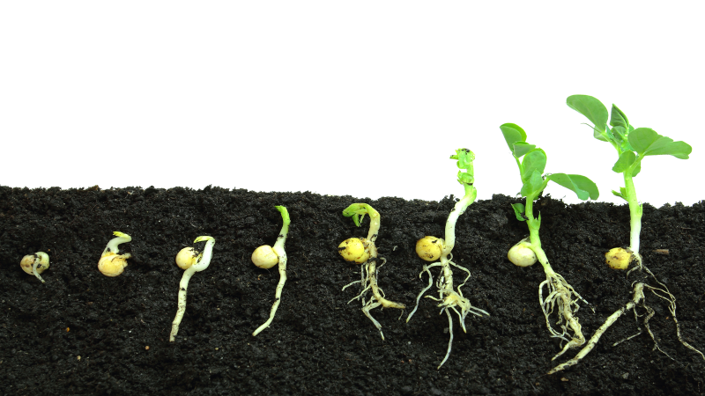

Slide 13
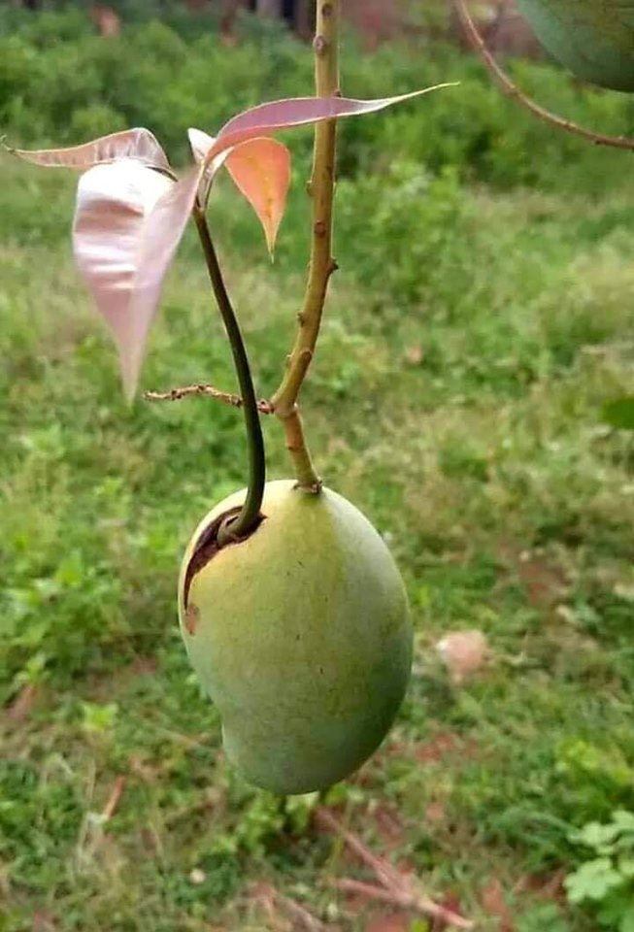

Slide 14
Seed dormancy is a critical adaptive strategy that allows seeds to survive unfavorable conditions and optimize their germination timing.
There are several classes of seed dormancy:
Physical Dormancy: Caused by a hard seed coat that prevents water and gases from entering
Physiological Dormancy: Involves internal factors even when environmental conditions are suitable. such as hormonal imbalances or inhibitors that prevent germination
Morphological Dormancy: Occurs when the embryo is not fully developed at maturity
Combinational Dormancy: A combination of physical and physiological dormancies, requiring multiple treatments to break.
Causes of Seed Dormancy
Environmental Factors: Conditions such as light, temperature, moisture levels, and soil type can influence the degree of dormancy. For example, some seeds require exposure to light or cold temperatures (stratification) to break dormancy
Genetic Factors: The genetic makeup of a seed affects its dormancy traits. Some species have evolved to have deeper dormancies based on their ecological niches, while others may have shallow dormancies that allow for quicker germination.
Maternal Effects: The conditions experienced by the mother plant during seed development can influence dormancy traits in seeds. Factors such as nutrient availability and environmental stress can affect how dormant a seed will be
Physiological Changes: As seeds age or are subjected to unfavorable conditions after imbibition (water absorption), they may enter a secondary dormancy state, which can be reversible depending on subsequent environmental changes
Hormonal Regulation: Plant hormones play a significant role in regulating dormancy and germination processes. For instance, abscisic acid (ABA) promotes dormancy, while gibberellins (GA) are associated with breaking dormancy and promoting germination

Slide 15
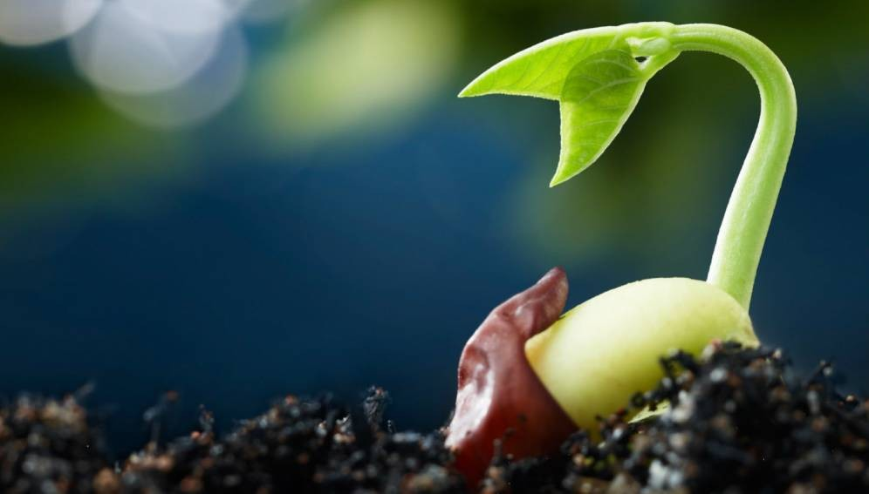

Slide 16
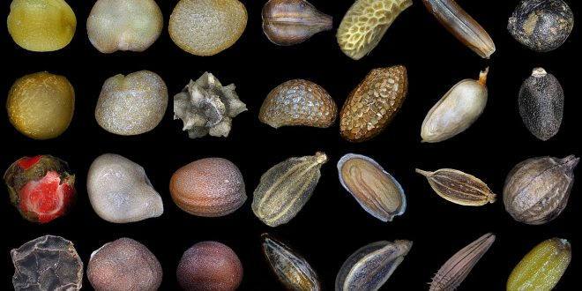

Slide 17
Method of Breaking the seed Dormancy | Type of Dormancy Addressed | Details
Scarification(Morning Glory, Sweet pea, Lupine) | Seed-coat Dormancy | Manual or chemical methods to damage seed coat.
Cold Stratification( | Embryo Dormancy | Moist storage at low temperatures for several days.
Preheating | Embryo Dormancy | Treatment at moderate temperatures to stimulate growth.
Gibberellic Acid (GA3) | Embryo Dormancy | Hormonal treatment to enhance metabolic activity.
Potassium Nitrate (KNO3) | Embryo Dormancy | Nutrient solution to promote germination.
Light Exposure | Light-sensitive Seeds | Providing adequate light during germination cycles.

